Slide 1
NUMBER SERIES

Slide 2
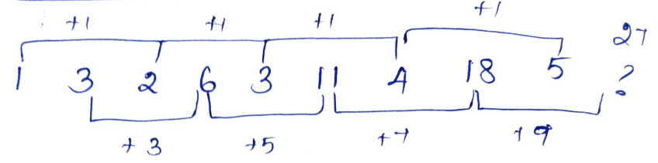
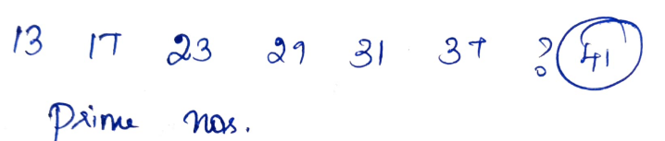
Basic Addition /Subtraction
1 ,3, 2, 6 ,3, 11, 4 ,18, 5, ?
13, 17, 23 ,29 ,31 ,37, ?

Slide 3
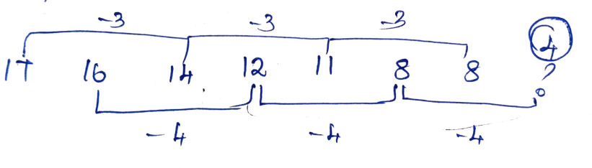
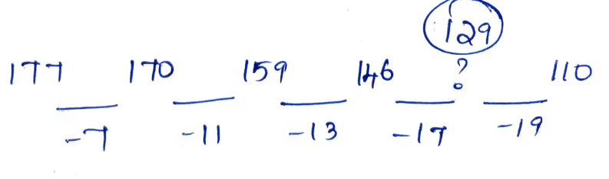
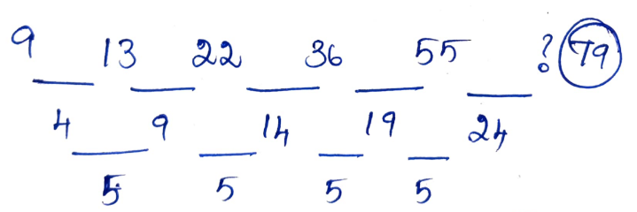
17, 16, 14 ,12 ,11, 8, 8, ?
9 13 22 36 55 ?
177, 170, 159, 146, ? ,110

Slide 4
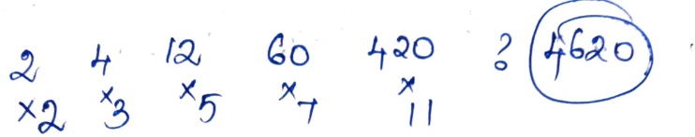
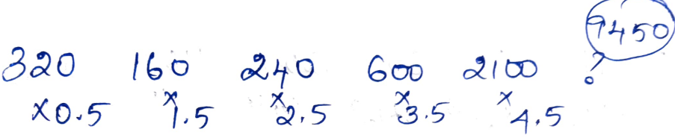
Multiplication and Addition/Subtraction
2, 4, 12, 60, 420, ?
320, 160, 240 ,600, 2100, ?

Slide 5
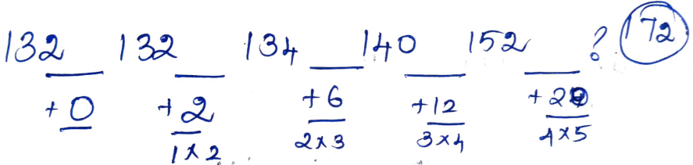
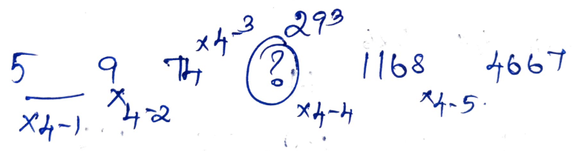
132, 132, 134, 140, 152, ?
5 , 19 , 74 , ? , 1168 , 4667

Slide 6
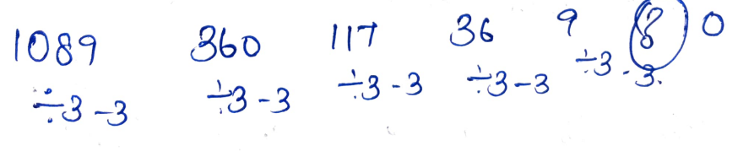
1089, 360, 117, 36, 9, ?

Slide 7
19, 17, 30, 82, 312, ?

Slide 8
11, 19, 65, 259, 1161, ?

Slide 9
Finding Wrong Term
6, 12, 24, 40, 74, 116

Slide 10
7.2, 72, 9, 54, 13.5, 28
Sol:
The pattern is
7.2 x 10 = 72
72 ÷ 8 = 9
9 x 6 = 54
54 ÷ 4 = 13.5
13.5 x 2 = 27
So, the wrong term is 28.

Slide 11
6, 15, 41, 179, 839, 5041
Sol:
Logic is
6 * 2 + 3 = 15,
15 * 3 â€“ 4 = 41,
41 * 4 + 5 = 169,
169 * 5 â€“ 6 = 839,
839 * 6 + 7 = 5041
Thus the wrong number is 179, it should be 169.

Slide 12
2, 3, 10, 39, 172, 882, 5346
Logic is
2 * 1 + 1 = 3,
3 * 2 + 22 = 10,
10 * 3 + 32 = 39,
39 * 4 + 42 = 172,
172 * 5 + 52 = 885,
885 * 6 + 62 = 5346

Slide 13
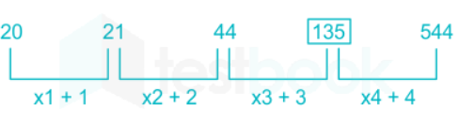
20, 21, 44, 135, 544, 2722
3 , 3 , 10 , 36 , 100 , 223

Slide 14
8, 19, 52, 151, 447, 1339
Sol:
The logic is 8 × 3 – 5 = 19, 19 × 3 – 5 = 52, 52 × 3 – 5 = 151.
So in place of 447, it should be 448.

